Slide 1

Info Sec Transience Identifying Ephemeral Security Assets with Machine Learning
Dan Tetrick
Microsoft - CDG Security
datetric@Microsoft.com

Slide 2
Agenda and Contact
Asset Inventory, Secure From Birth, & Transient/Durable Assets (5 min)
Transient & Durable Asset Analysis (5 min)
Binary Classifier & ML Workflow (5 min)
Transience Light GBM Classifier Notebook (25 min)
Future State & Next Steps (2 min)
Q & A (8 min)
GIT HUB: github.com/dantetrick/Transience_Databricks_LightGBMClassifier
SOCIAL: linkedin.com/in/dantetrick/

Slide 3
Why is Asset Inventory Important?
You can’t protect what you don’t know you have!
The ability to track and audit asset inventory is a requirement for many security standards, including the CIS, HIPAA, and PCI.
An effective asset inventory system allows you to support incident response, hunt, detection, analysis and machine learning functions.
When a security event happens, you need to know who to identify as the owner to begin remediation.

Slide 4
What is secure from birth?
Secure from Birth is a CDG Security initiative to ensure all assets in their inventory are created with monitoring and scanning – assuring optimal security, cradle to grave, for our customers’ assets.
A major issue security teams face when attempting to protect their inventory from birth is ephemeral or transient assets.
BUSINESS CASE: Identify customer services creating unmonitored / unscanned transient assets and work with them to get secure from birth by adjusting their business practices, image creation, etc…

Slide 5
What are Transient Assets?
Transient or ephemeral security assets are observed in inventory data for a short amount of time and then disappear from the data source. They create three major challenges to the goal of optimal security:
More Vulnerable
Inaccurate / Misrepresent Reporting
Loss of Credibility and Productivity
CDG Security provide a life-span value for each security asset in its inventory management system, then tracks the assets’ behavior to allow security teams the ability to process ephemeral assets per their business requirements.

Slide 6
What are Durable Assets?
Durable security assets can be observed in inventory data over a longer time period and are less susceptible to the challenges facing ephemeral assets.
A sample analysis of CDG security assets revealed that 3-days is an appropriate life-span to define the transient or durable classification. Assets appearing in the data for over 3-days are considered durable.
Each security business will need to analyze their inventory’s transient and durable threshold independently.

Slide 7
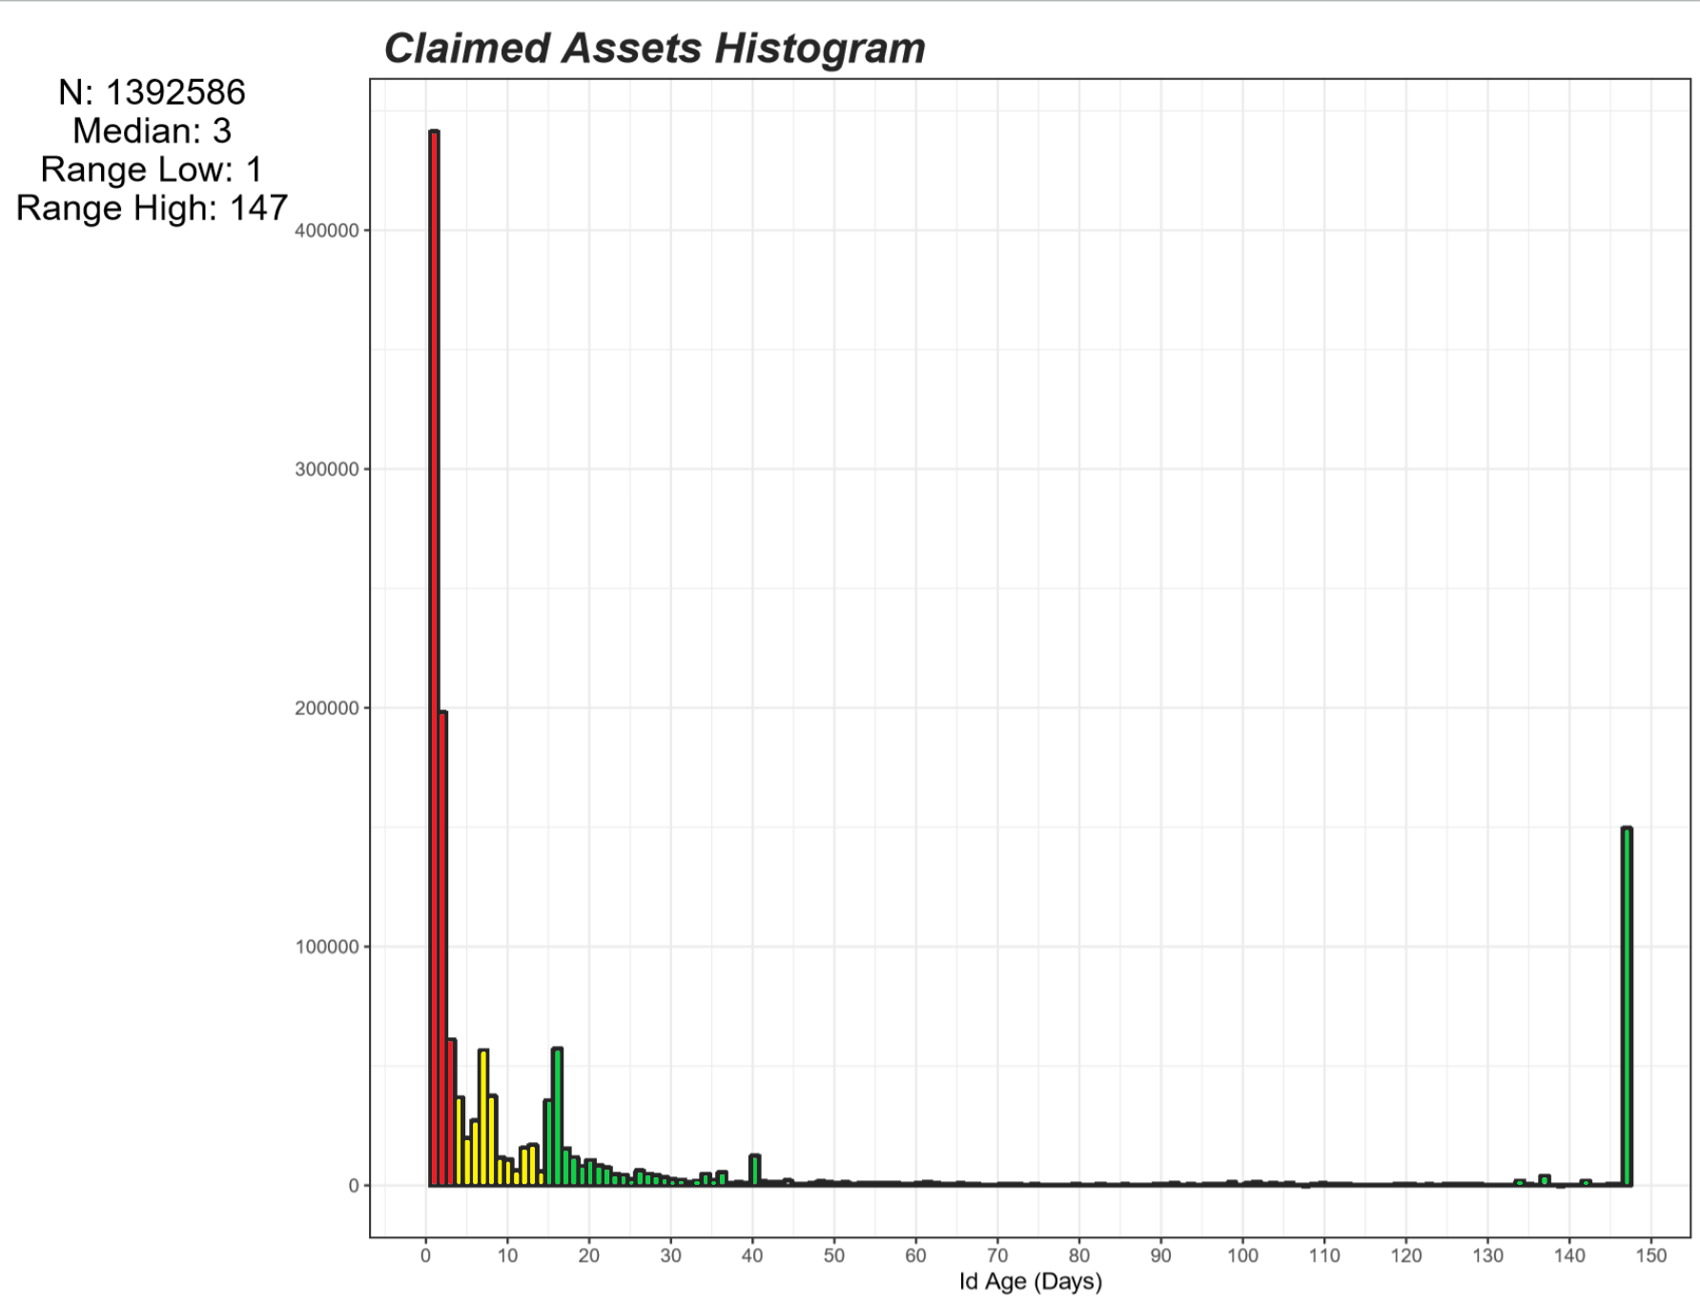
Transient Analysis
Id Age measures the number of days between the first and last date each asset was observed in our inventory .
50%
Overall, 1.4M assets were sampled over a 147-day study.
Over 701K (50%) were Transient and did not age past 3-days.
32%
18%
Only 411K (32%) were in the data over 14-days.

Slide 8
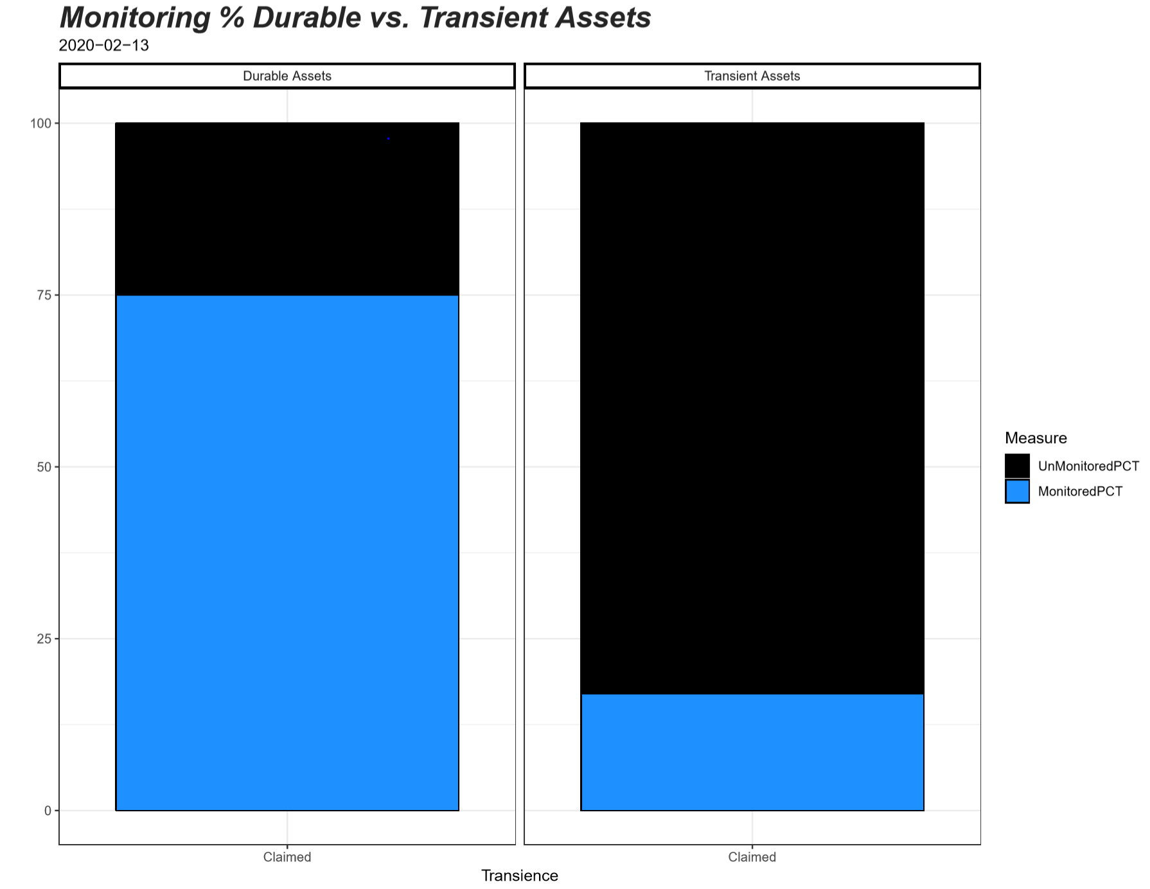

Why It Matters?
Monitoring and Scanning % are significantly different when comparing Durable and Transient assets.
Total > 3 Days: 143K
Total <= 3 Days: 7.4K
Segmenting assets by an Id Age of <= 3 days reveals a 58% difference in Monitoring. (~same for Scanning)
-58%
Durable assets are monitored 75% of the time, whereas Transient assets are only monitored 17% of the time.
Monitored Durable
108K (75%)
Monitored Transient
1.2K (17%)

Slide 9
Binary Classifier
Input data streams from Inventory are processed in Azure Data Lake (ADL)
To give CDG Security insight into which new assets entering their inventory will be transient, a binary classifier machine learning model was created.
Processed inventory data is ingested into Databricks Notebooks
Databricks Notebook
Data is parsed into 3 data sets for modeling:
1. ToPredict – New Assets need predictions
2. ToTrain – Random 70% Sample to Train Model
3. ToTest – Random 30% Sample to Test Model
ToTrain and ToTest
ToPredict
Light GBM Classifier
A LightGBM classifier predicts new assets transient probability
Predictions are sent to the data store (ADL)
Predictions to Data Store

Slide 10
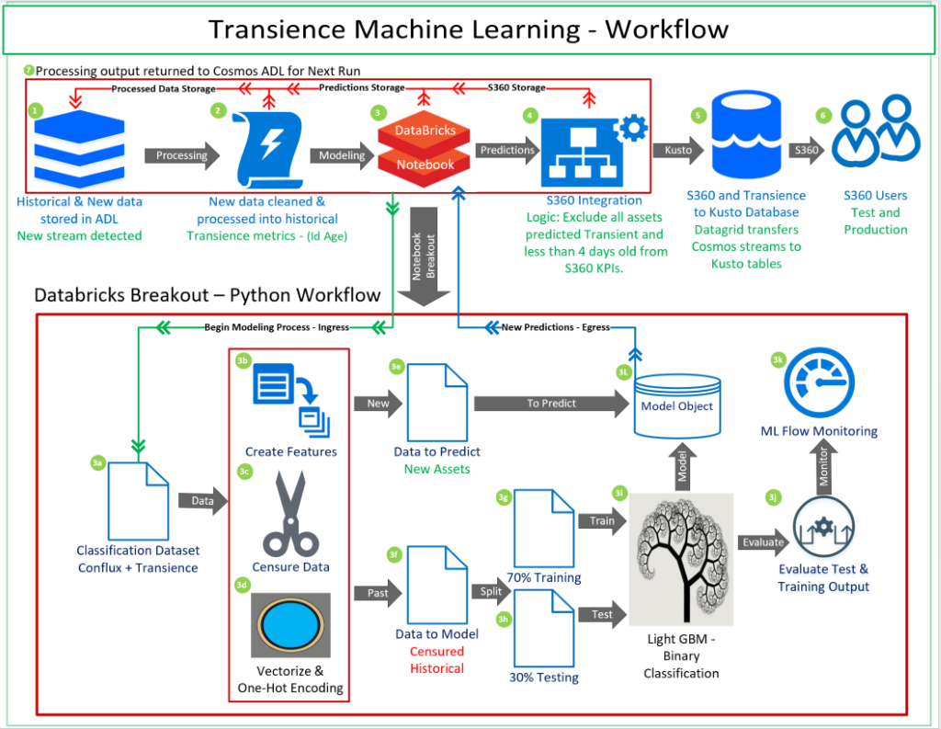

Slide 11
Transience Databricks Notebook
CLICK ICON

Slide 12
FUTURE STATE
Integrate Microsoft-wide inventory data platform (700M assets) as the source for transient methodology. This will allow all MSFT security teams to leverage the analysis and machine learning to handle ephemeral assets per their requirements.
Include a prediction of asset life-span (continuous numerical variable) w/ intervals to allow for users to incorporate more in-depth insights into their business.

Slide 13
Next steps
Transition data source to Microsoft-wide inventory data platform
Identify new ways to leverage transience as the lead indicator for the Secure from Birth initiative.
Research paper publication
MLADS presentation
Red Team leveraging Transience data
Expand data science tech and tools to other security problems.

Slide 14
Q&A

